Slide 1
Deriving Effective Permissions for Modeling Artifacts from Fine-grained Access Control Rules
Csaba Debreceni, Gábor Bergmann, István Ráth and Dániel Varró

Slide 2




Collaborative Modelling
1a) Checkout
VCS
1b) Checkout
1a) View
Web Server
1b) View
6) Commit
4) Immediate change propagation
2) Commit
3) Immediate model change
5) Merge (Resolved conflict)
4) Conflict
5) Updated model
3) Commit attempt
2) Modify
Local Copy₁
Local Copy₂

Slide 3





Access Control
View for SW Provider₁
View for SW Provider₂
View for HW Supplier₁
Integrated System Model
Different privileges for
Stakeholders
Subcontractors
In-house teams
Writable by HW Supplier₁
Challenge: How to provide secure access for collaboration?

Slide 4



Secured Offline Collaboration
Accessible by standard VCS protocols
User B
No Access
User A
GET
PUTBACK
version
version
version
Version History
GET
Front repo of User B
„Gold” VCS repo
Front repo of User A

Slide 5

Secured Online Collaboration
Collaboration Server
„Whiteboard” (online session)
LENS
LENS
GET
GET
„Gold” model
PUTBACK
„Front” model for User B
„Front” model for User B
„Front” model for User A
„Front” model for User A
Accessible in web browser
Accessible in web browser
User B
User A

Slide 6

Fine-grained Query-based AC
Hide
Obfuscate
GET
Check
PUTBACK
„Gold” model
„Front” model for User A
Challenge:
How to resolve contradicting access control rules?
Gábor Bergmann, Csaba Debreceni, István Ráth and Dániel Varró: Query-based Access Control
for Secure Collaborative Modeling using Bidirectional Transformations, MODELS’16

Slide 7

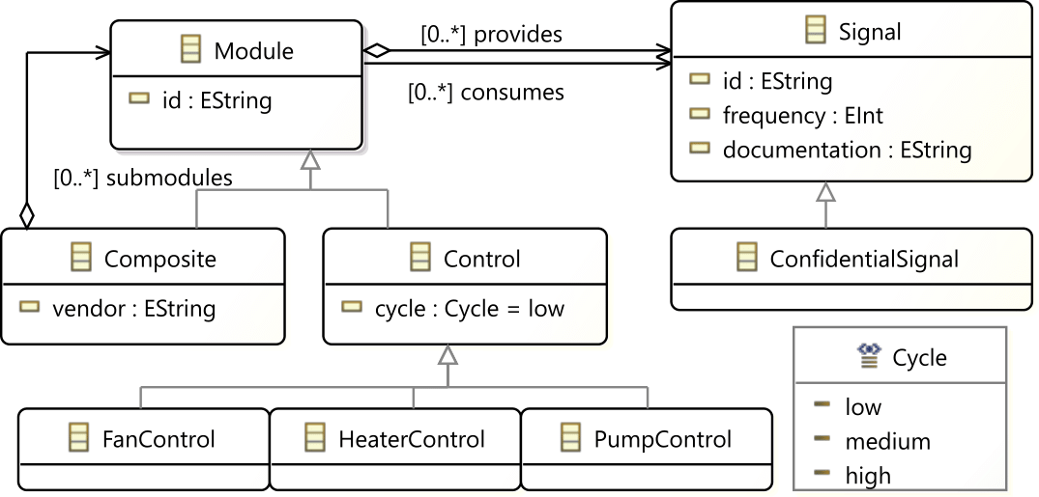



Running Example
Case Study of MONDO Project
Executed efficiently as live transformation (Viatra)
Different Users
with different access control
Executed efficiently as live transformation (Viatra)
Administrator
Pump Control Engineer
Heater Control Engineer

Slide 8
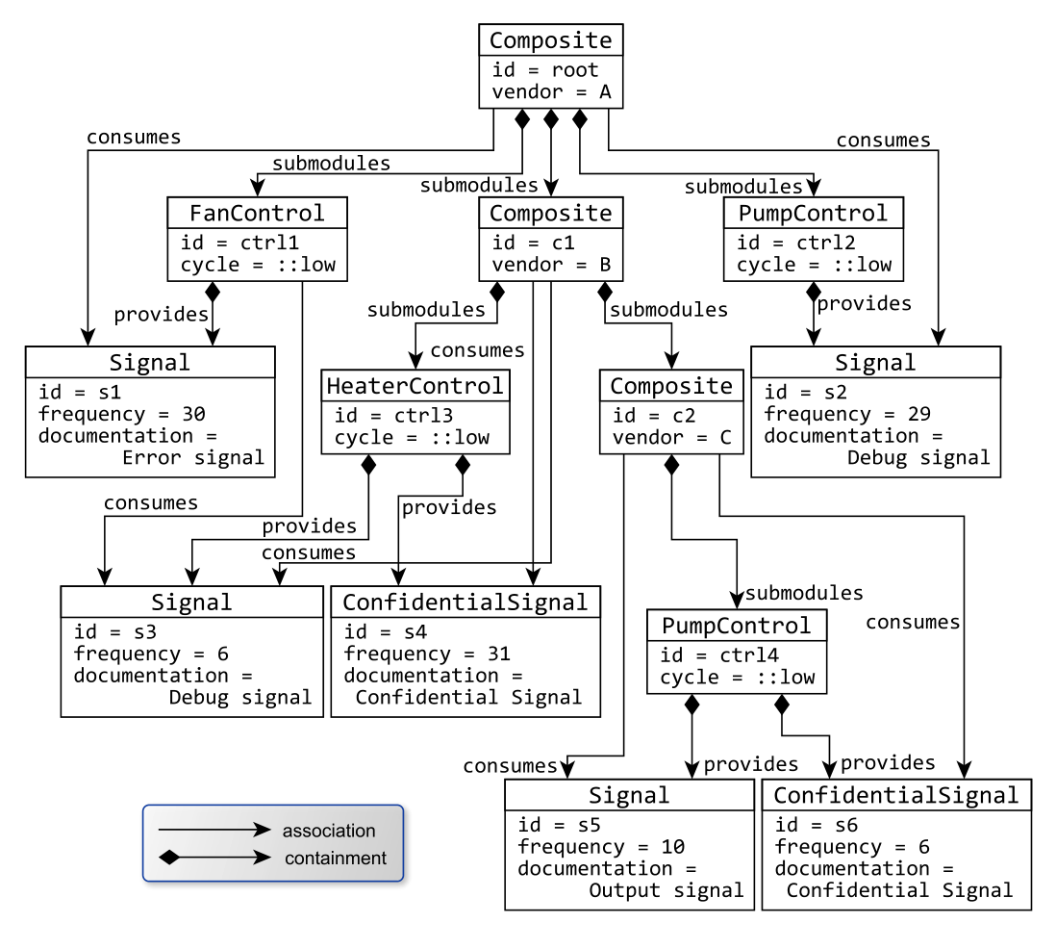
Access Control Rules
Heater Control Engineer
R1: Each group of specialists shall be responsible for a specific kind of control unit

Slide 9
Access Control Rules
R2: Specialists must see only those signals that are in scope for their owned control units
Heater Control Engineer

Slide 10
Access Control Rules
Heater Control Engineer
R3: Specialists must be able to modify signals provided by their owned control units
W
W

Slide 11
Access Control Rules
Heater Control Engineer
R4: Specialists must see which modules consume signals provided by their owned control units
W
W

Slide 12
Access Control Rules
Heater Control Engineer
R5: Specialists must not able to see confidential signals.
X
W
W
X

Slide 13
Access Control Rules
Pump Control Engineer
W
X
X

Slide 14
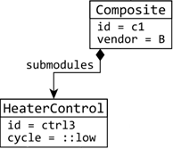
Query-based Access Control Rules
Graph Queries select Assets
Object Assets Obj(id, type)
e.g. Obj(c1, Composite)
Reference Assets Ref(name, src, trg)
e.g. Ref(submodules, c3, ctrl3)
Attribute Assets Attr(name, src, value)
e.g. Attr(cycle, ctrl3, ::low)
Rules are applied on assets
Access: allow, obfuscate, deny
Operation: Read (R), Write (W)
allow R Obj(c1, Composite)

Slide 15
Goals
Policy language for Access Control Rules
Synthesize consistent secured models
Deterministic conflict resolution

Slide 16
Policy Language

Slide 17
Policy Language
policy Example deny RW by default {
}
Default rules for all assets in the model

Slide 18
Policy Language
policy Example deny RW by default {
rule permitControl allow RW to HCEngineer {
} with 1 priority
}
Specify permissions of operations to users/groups
OPTIONAL: External Priorities

Slide 19
Policy Language
policy Example deny RW by default {
rule permitControl allow RW to HCEngineer {
query objectControls
} with 1 priority
}
objectControls (obj)
obj: HeaterControl

Slide 20
Policy Language
policy Example deny RW by default {
rule permitControl allow RW to HCEngineer {
query objectControls
} with 1 priority
rule viewSignal allow R to HCEngineer {
query objectSignals
} with 3 priority
}
objectSignals (obj)
HeaterControl
obj: Signal
or
Composite
Transitive Closure
HeaterControl
…
obj: Signal

Slide 21
Policy Language
policy Example deny RW by default {
rule permitControl allow RW to HCEngineer {
query objectControls
} with 1 priority
rule viewSignal allow R to HCEngineer {
query objectSignals
} with 3 priority
} with restrictive resolution
Internal Priority
deny < obfuscate < allow
Restrictive | Permissive

Slide 22
Consistent Secured Models

Slide 23
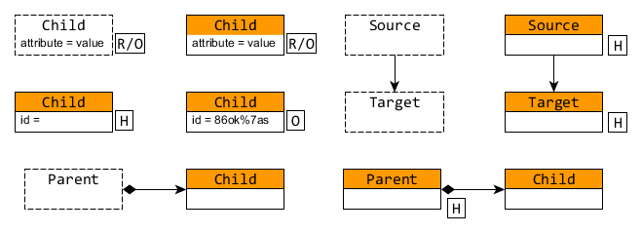
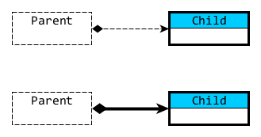
Consistent Secured Models
Internal Consistencies
Dangling Edges
Containment Hierarchy
Multiplicity Constraints

Slide 24
Consistent Secured Models
Internal Consistencies
Dangling Edges
Containment Hierarchy
Multiplicity Constraints

Slide 25
Consistent Secured Models
Internal Consistencies
Dangling Edges
Containment Hierarchy
Multiplicity Constraints

Slide 26
Consistent Secured Models
Internal Consistencies
Dangling Edges
Containment Hierarchy
Multiplicity Constraints

Slide 27
Consistent Secured Models
Internal Consistencies
Dangling Edges
Containment Hierarchy
Multiplicity Constraints

Slide 28
Consistent Secured Models
Internal Consistencies
Dangling Edges
Containment Hierarchy
Multiplicity Constraints

Slide 29
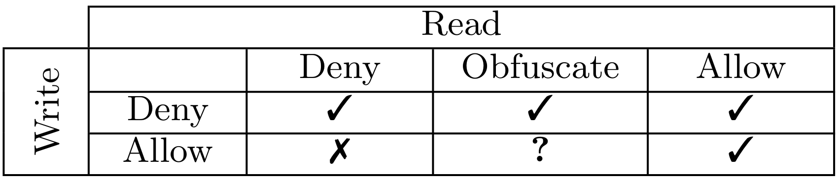
Consistent Secured Models
Internal Consistencies
Dangling Edges
Containment Hierarchy
Multiplicity Constraints
Compatibility Matrix

Slide 30
Conflict Resolution

Slide 31
Conflict Resolution
Maintaining a set of Judgments
J(asset, access, operation, priority)
allow,obfuscate,deny
R or W

Slide 32
Conflict Resolution
Maintaining a set of Judgments
J(asset, access, operation, priority)

Slide 33
Conflict Resolution
Maintaining a set of Judgments
J(asset, access, operation, priority)
e.g. J(obj(c1,Composite), deny, R, def)
deny R

Slide 34
Conflict Resolution
Maintaining a set of Jugments
J(asset, access, operation, priority)
e.g. J(obj(c1,Composite), deny, R, def)
Elementary conflicts of Judgments
allow R ←→ deny R
Using Priorities (External/Internal)
Restrictive / Permissive

Slide 35
Conflict Resolution
Maintaining a set of Judgments
J(asset, access, operation, priority)
e.g. J(obj(c1,Composite), deny, R, def)
Elementary conflicts of Judgments
allow R ←→ deny R
Using Priorities (External/Internal)
Restrictive / Permissive
Extend the Judgments
Internal Consistencies
Compatibility Matrix
allow R
J(obj(ctrl3,HeaterControl),allow,R,1)

Slide 36
Conflict Resolution
Maintaining a set of Judgments
J(asset, access, operation, priority)
e.g. J(obj(c1,Composite), deny, R, def)
Elementary conflicts of Judgments
allow R ←→ deny R
Using Priorities (External/Internal)
Restrictive / Permissive
Extend the Judgments
Internal Consistencies
Compatibility Matrix
allow R
allow R
J(obj(ctrl3,HeaterControl),allow,R,1)
+J(obj(c1,Composite),allow,R,1)

Slide 37
Conflict Resolution
Maintaining a set of Judgments
J(asset, access, operation, priority)
e.g. J(obj(c1,Composite), deny, R, def)
Elementary conflicts of Judgments
allow R ←→ deny R
Using Priorities (External/Internal)
Restrictive / Permissive
Extend the Judgments
Internal Consistencies
Compatibility Matrix
allow W
J(attr(c1,vendor,B),allow,W,m)

Slide 38
Conflict Resolution
Maintaining a set of Judgments
J(asset, access, operation, priority)
e.g. J(obj(c1,Composite), deny, R, def)
Elementary conflicts of Judgments
allow R ←→ deny R
Using Priorities (External/Internal)
Restrictive / Permissive
Extend the Judgments
Internal Consistencies
Compatibility Matrix
allow W
allow R
J(attr(c1,vendor,B),allow,W,m)
+J(attr(c1,vendor,B),allow,R,m)

Slide 39
Conclusion and Future Work
Anylizing Conflicts and Dependencies
Operation types
Same/Different Assets
Formal Treatment of Conflict Resolution
Internal Judgments
Effective Permissions
Provided Algorithm
Deterministic Resolution
Consistent Secured Model
Fine-tuned Resolution
Provide detailed textual syntax for the language
Pre-select specific sets of options (like XACML)
Incremental Evalution of Effective Permissions

